Slide 1
Accelerometer Activity Recognition
Made with ThingsBoard and Node.js

Slide 2
Main idea
We want to build a web application that collects data from the accelerometer in a mobile phone and does some activity recognition (it will be possible to see if the user is standing still, is walking or if he’s running).
Cloud-based deployment: activity recognition is done in the cloud platform when new data arrives.
The data is visualized in the dashboard we used for the previous
assignments, where we’ll see the latest values collected and the activity
detected, together with the history of the values collected in the last hour
and the resulting activity.
Edge-based deployment: activity recognition is done in the mobile phone, when new values are read from the accelerometer, and then the data is sent to the cloud platform.
The activity detected will be visualized in real time on the page displayed to
the user, and it will also be possible to look at the activities collected during
the last hour.

Slide 3
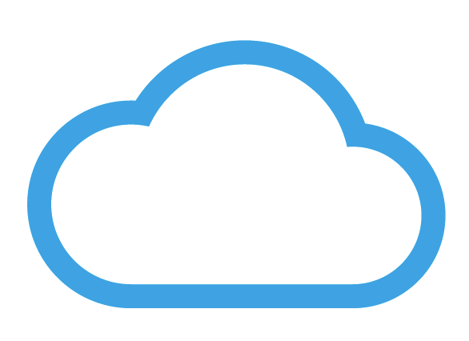


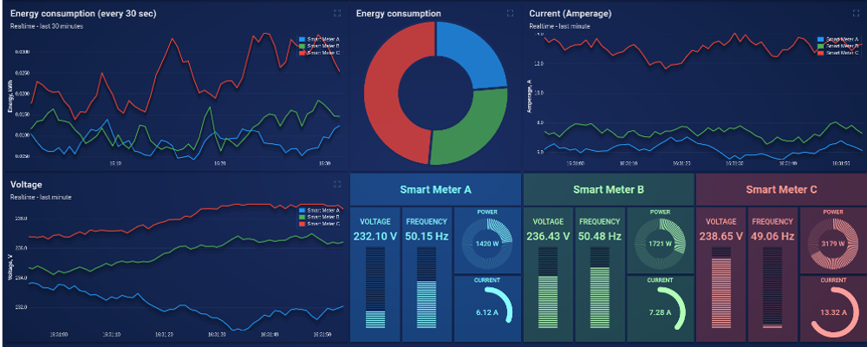

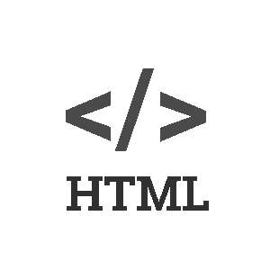
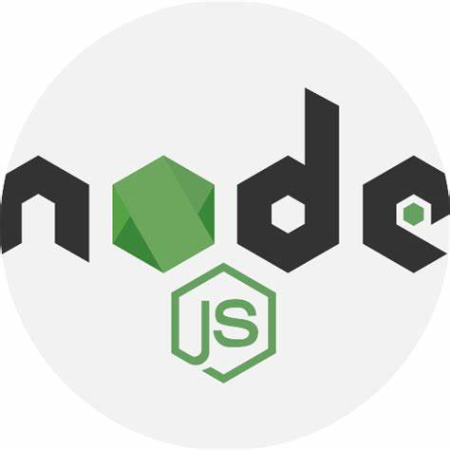
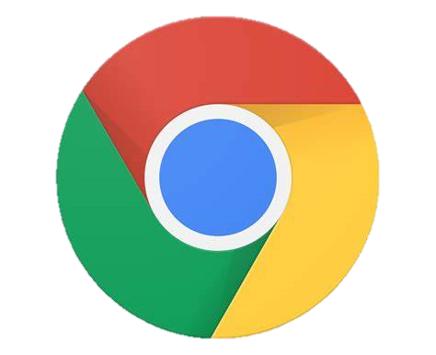
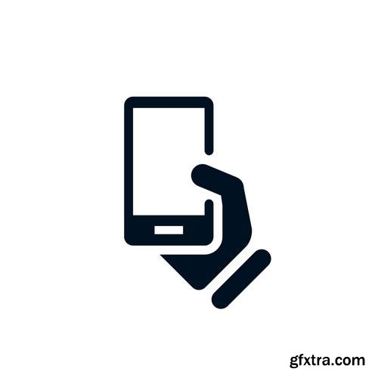

Cloud-based Architecture
ThingsBoard IoT Platform
Activity Recognition
MQTT Channel
ThingsBoard Dashboard
HTTPS
HTTPS
Android Phone
Node JS app on Heroku
A

Slide 4
Edge-based Architecture
ThingsBoard IoT Platform
Activity Recognition
MQTT Channel
ThingsBoard Dashboard
HTTPS
HTTPS
Android Phone
Node JS app on Heroku
A

Slide 5
Implementation
We can have access to the accelerometer data thanks to the Generic Sensor API. To use them, we need to use Google Chrome as a browser, activating some flags. The client is served an HTML page with some JavaScript that collects data and makes the page responsive. Please note that you can activate these flags only on an Android phone.
The web app is built with Node JS, which forwards data to the cloud platform via MQTT. To exchange data from the front-end to the back-end and viceversa we use HTTP methods GET and POST.
The deploy is done with Heroku.
The cloud platform used is ThingsBoard. Thanks to its rule chain we can easily process data in the cloud-based scenario, and the data is visualized on the dashboard.

Slide 6
Technology: client-side
Generic Sensor API: is a framework promoted by the W3C to expose data collected through sensors in a consistent way, especially on mobile phones.
Google Chrome: a web browser developed by Google. It’s currently the most used browser.
HTML: is a markup language, the standard used to define documents to be displayed by web browsers. Often used with CSS for styling and with JavaScript to enhance functionalities.
JavaScript: is an object oriented and event oriented programming language. It’s very versatile, and is used in the majority of web application to program the client-side.

Slide 7
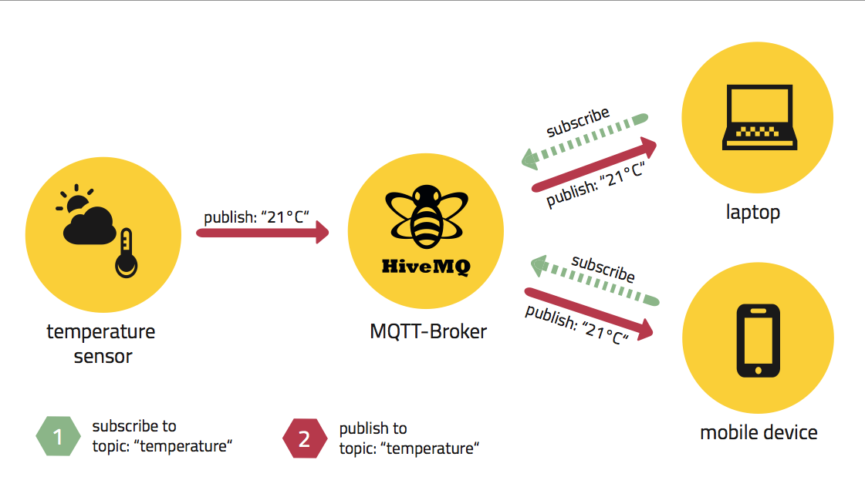
Technology: MQTT Protocol
MQTT is a machine-to-machine connectivity protocol, designed to be lightweight
and work well even in situations where little resources are provided.
Because of this, it’s ideal for sensor communication.
It’s based on the publish subscriber paradigm

Slide 8

Technology: Node.js
Node.js is a JavaScript runtime environment that uses V8 JavaScript Engine (which makes it very smooth and powerful).
It’s run in a single process, without creating a new thread for every connection. In general, it’s thought for an asynchronous and event-driven programming style.
It’s very popular, and has a huge amount of frameworks and libraries.

Slide 9
Technology: Heroku
Heroku is a cloud platform where you can deploy your applications. It has been in development since 2007, and supports many programming languages, such as Ruby, Scala, Go, NodeJS, Clojure, Python, PHP and Java.
It has different payment plans, but for our purposes the free plan is more than enough.

Slide 10
Technology: ThingsBoard
ThingsBoard is an open-source IoT platform to collect, process, visualize data and manage devices.
Enables connectivity through standard IoT protocols like CoAP, HTTP, MQTT and supports cloud deployment.
The pillars of this platform are scalability, fault-tolerance and performance.

Slide 11
References
Generic Sensor API: https://w3c.github.io/sensors/
HTML: https://html.spec.whatwg.org/multipage/
JavaScript: https://en.wikipedia.org/wiki/JavaScript
Google Chrome: https://en.wikipedia.org/wiki/Google_Chrome
Node.js: https://nodejs.org/en
MQTT: https://mqtt.org/
Heroku: https://www.heroku.com/
ThingsBoard: https://thingsboard.io

Slide 12
Thank you for you attention!

